Slide 1
学術大会, 支部例会でこのテンプレートをそのまま使用する必要はありません.
症例報告を行う際, 最低この程度の患者情報はお入れくださいというものです.
特定非営利活動法人日本臨床歯科医学会学術委員会

Slide 2
Title
Lecturer

Slide 3
日本臨床歯科医学会
第 回学術大会/総会
利益相反(Conflict Of Interest: COI)開示
年 月 日
筆頭発表者氏名:
本演題に関して, 発表者の開示すべき利益相反状態はありません.

Slide 4
日本臨床歯科医学会
第 回学術大会/総会
利益相反(Conflict Of Interest: COI)開示
年 月 日
筆頭発表者氏名:
本演題に関して, 発表者の開示すべき利益相反状態は下記の通りです.
企業、組織や団体名

Slide 5
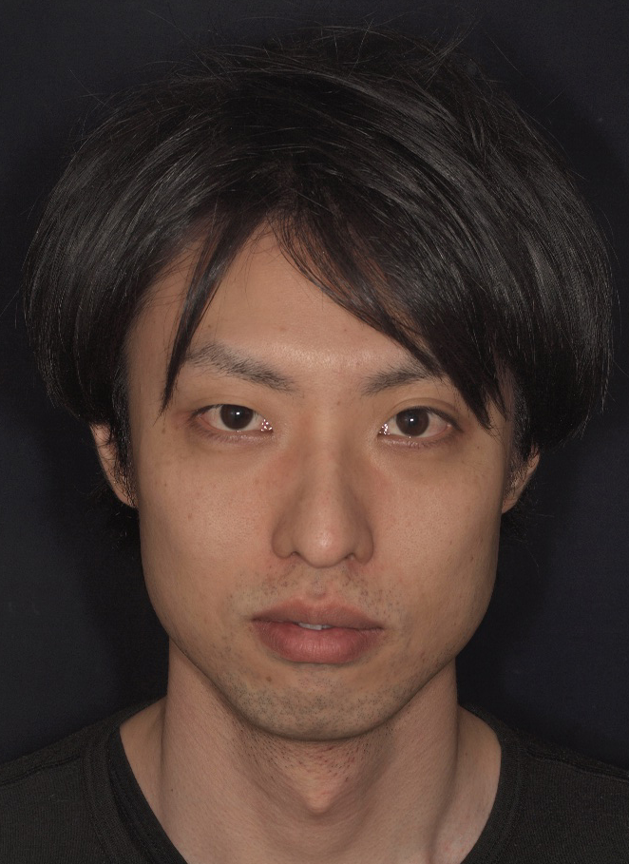
First visit
FV: 28th January 20014
Patient
L. D. (Age: 30)
Profession
Certified dental technician
Medical history
Healthy, smoker, allergic to spicy food
Dental history
Bruxism
Complaints
Impaired ability to masticate, sometimes pain (TMJ)
Wish
Gain a beautiful

Slide 6
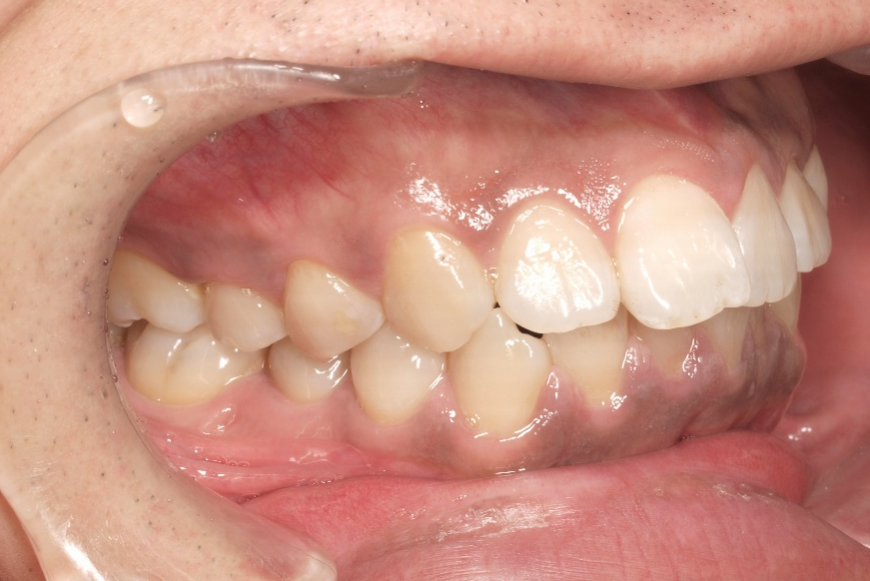
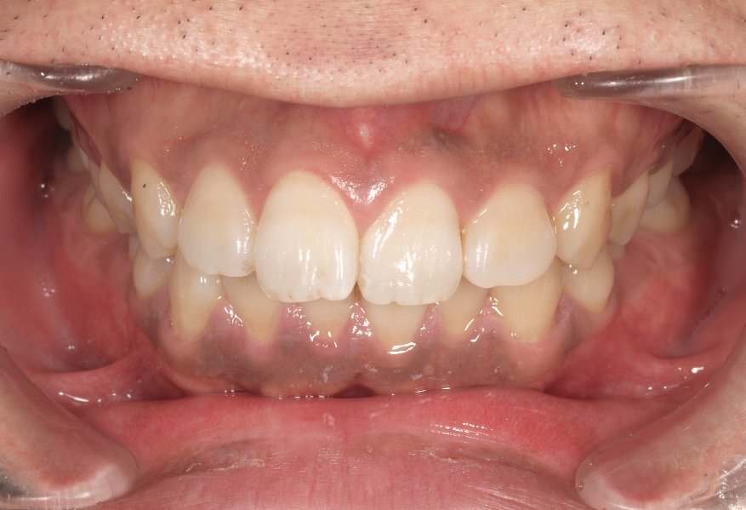
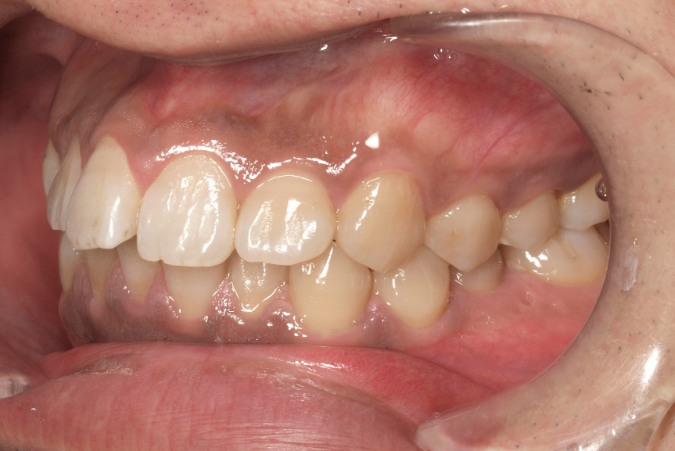
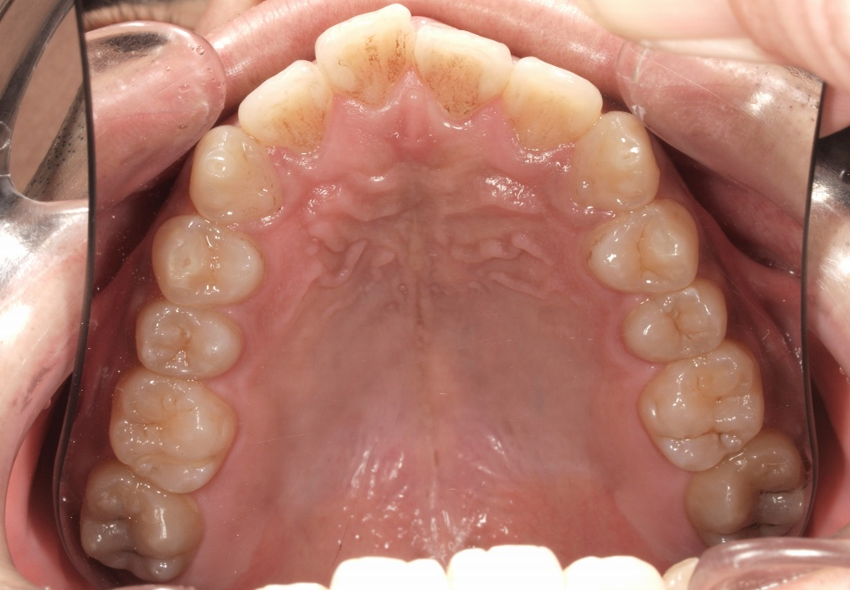
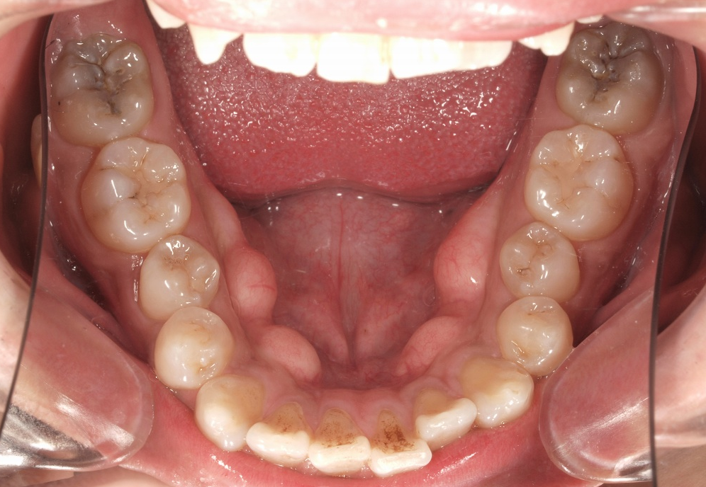
Intraoral Examination
Alignment of teeth is not good
Torus mandibularis
Caries
Old resin filling
Caries

Slide 7
Dental Examination
Present arch
18 | 17 | 16 | 15 | 14 | 13 | 12 | 11 | 21 | 22 | 23 | 24 | 25 | 26 | 27 | 28
48 | 47 | 46 | 45 | 44 | 43 | 42 | 41 | 31 | 32 | 33 | 34 | 35 | 36 | 37 | 38
Insufficient restoration
18 | 17 | 16 | 15 | 14 | 13 | 12 | 11 | 21 | 22 | 23 | 24 | 25 | 26 | 27 | 28
48 | 47 | 46 | 45 | 44 | 43 | 42 | 41 | 31 | 32 | 33 | 34 | 35 | 36 | 37 | 38
Caries tooth
18 | 17 | 16 | 15 | 14 | 13 | 12 | 11 | 21 | 22 | 23 | 24 | 25 | 26 | 27 | 28
48 | 47 | 46 | 45 | 44 | 43 | 42 | 41 | 31 | 32 | 33 | 34 | 35 | 36 | 37 | 38
Migration, Tilting, Elongation
18 | 17 | 16 | 15 | 14 | 13 | 12 | 11 | 21 | 22 | 23 | 24 | 25 | 26 | 27 | 28
48 | 47 | 46 | 45 | 44 | 43 | 42 | 41 | 31 | 32 | 33 | 34 | 35 | 36 | 37 | 38
Mobile tooth
18 | 17 | 16 | 15 | 14 | 13 | 12 | 11 | 21 | 22 | 23 | 24 | 25 | 26 | 27 | 28
48 | 47 | 46 | 45 | 44 | 43 | 42 | 41 | 31 | 32 | 33 | 34 | 35 | 36 | 37 | 38
Hopeless tooth, Planned for extraction
18 | 17 | 16 | 15 | 14 | 13 | 12 | 11 | 21 | 22 | 23 | 24 | 25 | 26 | 27 | 28
48 | 47 | 46 | 45 | 44 | 43 | 42 | 41 | 31 | 32 | 33 | 34 | 35 | 36 | 37 | 38

Slide 8
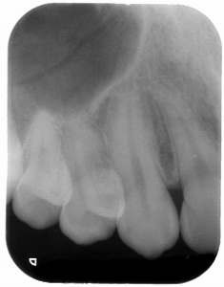
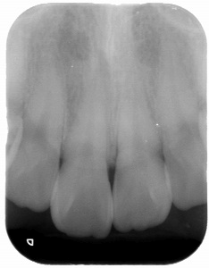
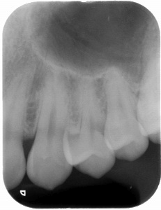
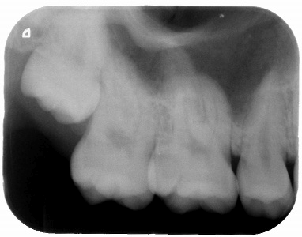
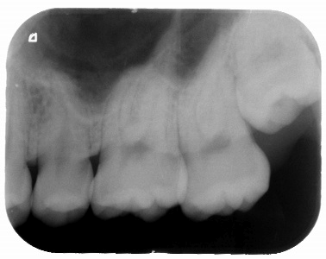
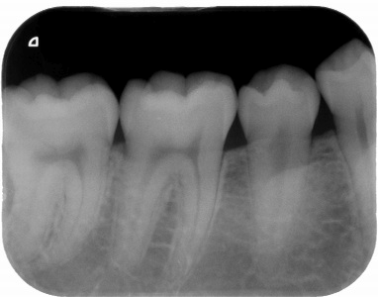
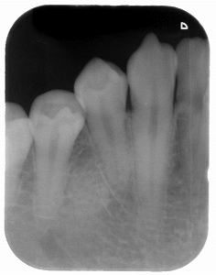
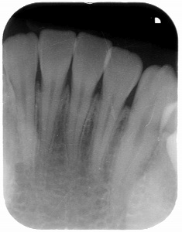
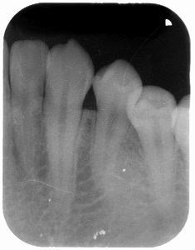
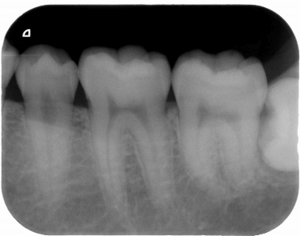
Periodontal Examination
Bleeding on probing
B
 | 3 2 3 | 3 2 3 | 3 2 3 | 3 2 3 | 3 2 3 | 3 2 3 | 3 2 3 | 3 2 3 | 3 2 3 | 3 2 3 | 3 2 3 | 3 2 3 | 3 2 3 | 3 2 3
18 | 17 | 16 | 15 | 14 | 13 | 12 | 11 | 21 | 22 | 23 | 24 | 25 | 26 | 27 | 28
 | 3 2 3 | 3 2 3 | 3 2 3 | 3 2 3 | 3 2 3 | 3 2 3 | 3 2 3 | 3 2 3 | 3 2 3 | 3 2 3 | 3 2 3 | 3 2 3 | 3 2 3 | 3 2 3
B
P
P
L
 | 3 2 3 | 3 2 3 | 3 2 3 | 3 2 3 | 3 2 3 | 3 2 3 | 3 2 3 | 3 2 3 | 3 2 3 | 3 2 3 | 3 2 3 | 3 2 3 | 3 2 3 | 3 2 3
48 | 47 | 46 | 45 | 44 | 43 | 42 | 41 | 31 | 32 | 33 | 34 | 35 | 36 | 37 | 38
 | 5 2 3 | 3 2 3 | 3 2 3 | 3 2 3 | 3 2 3 | 3 2 3 | 3 2 3 | 3 2 3 | 3 2 3 | 3 2 3 | 3 2 3 | 3 2 3 | 3 2 3 | 3 2 4
L
B
B
Notes:
Now, let’s move on to the clinical case.
The patient was 45 years old male.

Slide 9
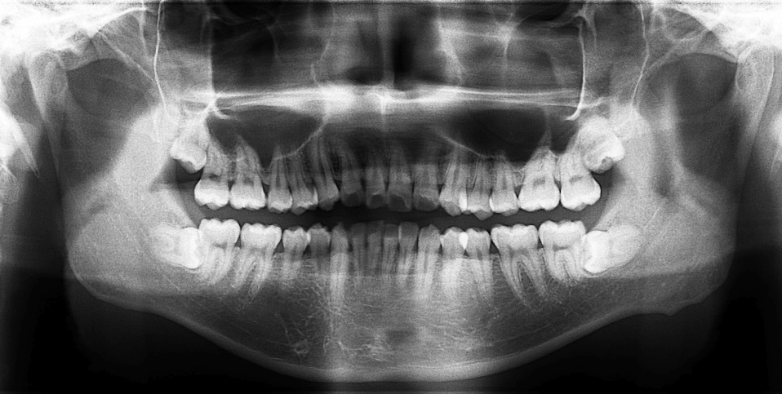
Radiographic Findings

Slide 10
Functional Findings - Occlusion
Occlusion type
Overbite
Overjet
Relaxed guided movement
TMJ
Additional findings
Class 1
Possible
NP
N/A
2mm
3mm
Notes:
Now, let’s move on to the clinical case.
The patient was 45 years old male.

Slide 11
Functional Findings - Occlusion Articulation
Lateral movement contacts (Right)
18 | 17 | 16 | 15 | 14 | 13 | 12 | 11 | 21 | 22 | 23 | 24 | 25 | 26 | 27 | 28
48 | 47 | 46 | 45 | 44 | 43 | 42 | 41 | 31 | 32 | 33 | 34 | 35 | 36 | 37 | 38
Contacts during protrusion
18 | 17 | 16 | 15 | 14 | 13 | 12 | 11 | 21 | 22 | 23 | 24 | 25 | 26 | 27 | 28
48 | 47 | 46 | 45 | 44 | 43 | 42 | 41 | 31 | 32 | 33 | 34 | 35 | 36 | 37 | 38
Lateral movement contacts (Left)
18 | 17 | 16 | 15 | 14 | 13 | 12 | 11 | 21 | 22 | 23 | 24 | 25 | 26 | 27 | 28
48 | 47 | 46 | 45 | 44 | 43 | 42 | 41 | 31 | 32 | 33 | 34 | 35 | 36 | 37 | 38
Notes:
Now, let’s move on to the clinical case.
The patient was 45 years old male.

Slide 12
Functional Findings - Occlusion Articulation
Premature contact
18 | 17 | 16 | 15 | 14 | 13 | 12 | 11 | 21 | 22 | 23 | 24 | 25 | 26 | 27 | 28
48 | 47 | 46 | 45 | 44 | 43 | 42 | 41 | 31 | 32 | 33 | 34 | 35 | 36 | 37 | 38
Interference
18 | 17 | 16 | 15 | 14 | 13 | 12 | 11 | 21 | 22 | 23 | 24 | 25 | 26 | 27 | 28
48 | 47 | 46 | 45 | 44 | 43 | 42 | 41 | 31 | 32 | 33 | 34 | 35 | 36 | 37 | 38
Notes:
Now, let’s move on to the clinical case.
The patient was 45 years old male.

Slide 13
Tooth Prognosis
● Secure ● Unsecure ● Poor ● Irrational to treat
●
●
●
●
●
●
●
●
●
●
●
●
●
●
●
●
●
●
●
●
●
●
●
●
●
●
●
●

Slide 14
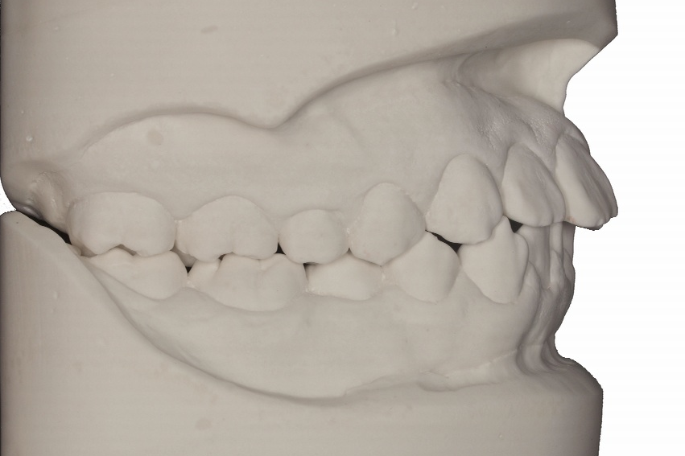
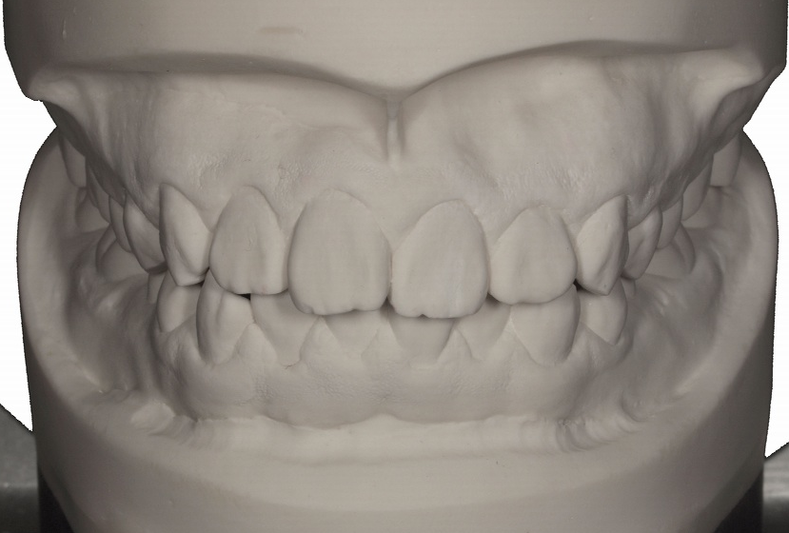
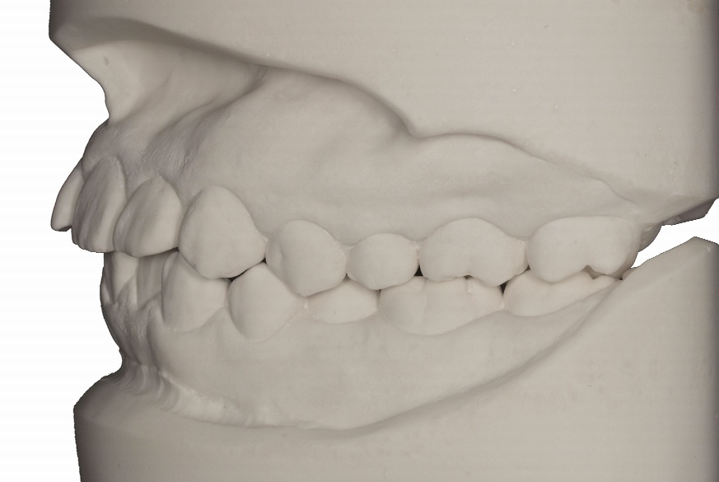
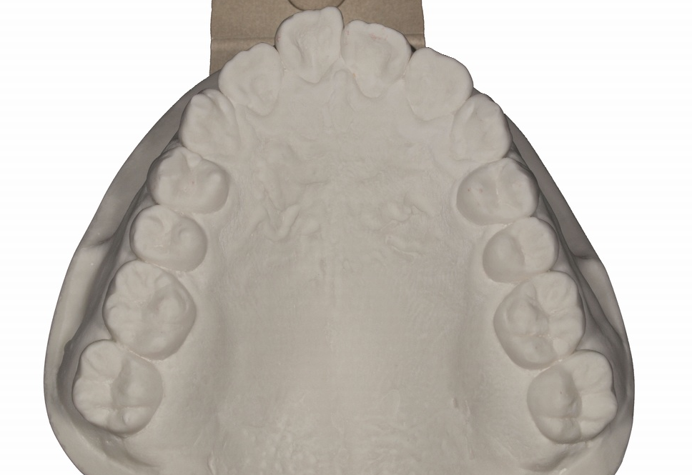
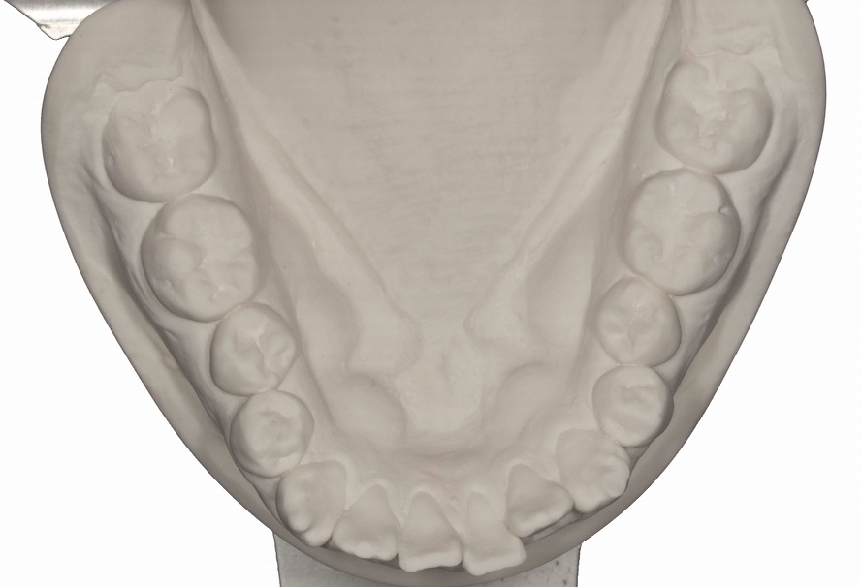
Stone model on the articulator

Slide 15
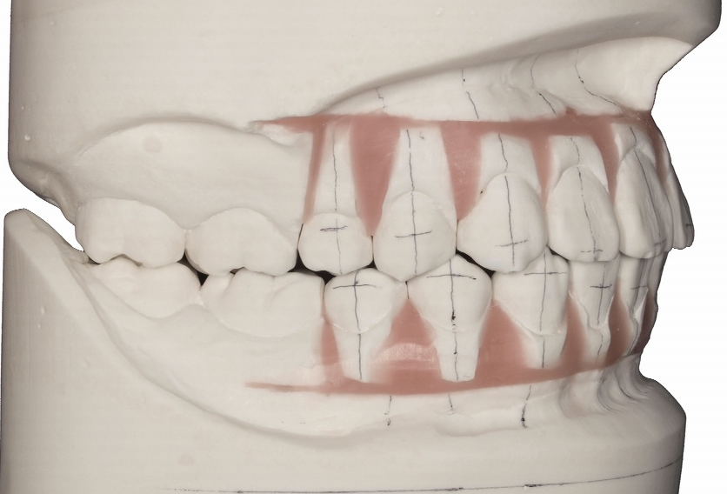
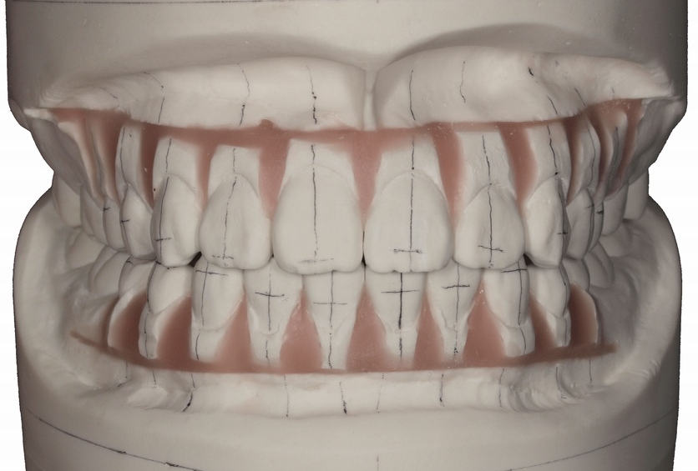
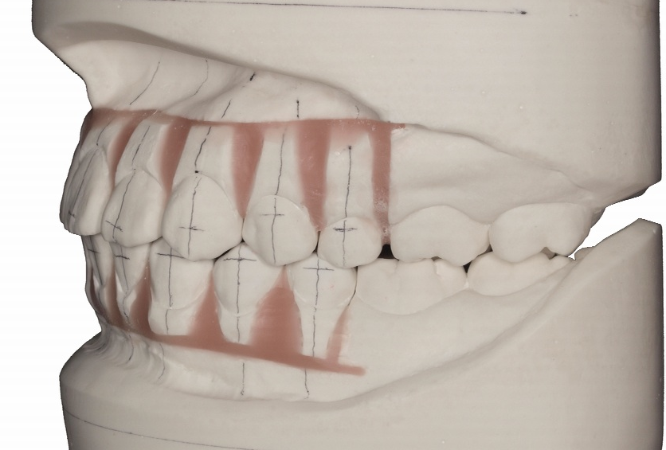
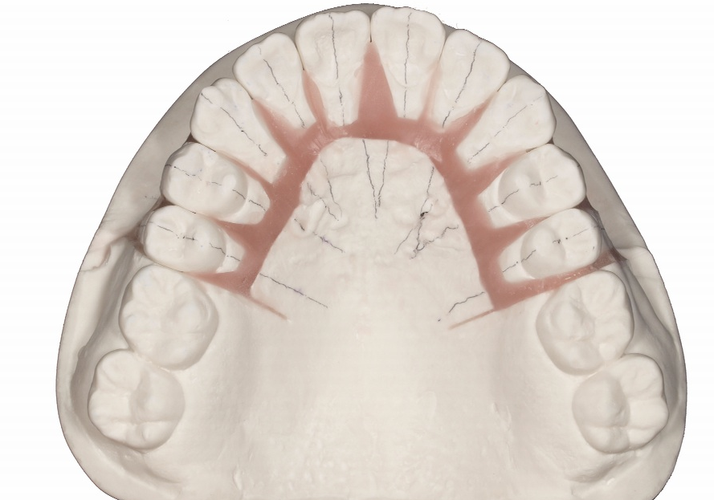
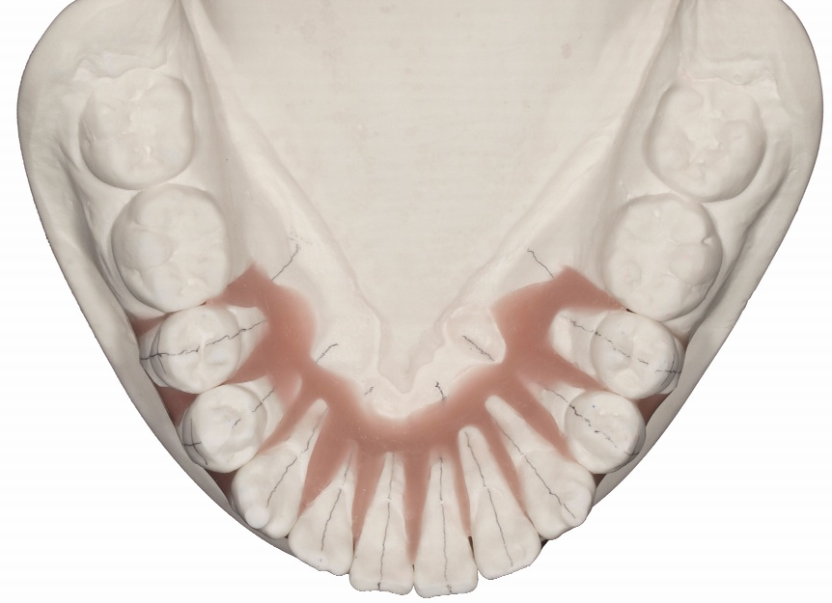
Wax-up / Mock-up on the articulator

Slide 16
Treatment Planning
First stage: Initial treatment
Caries treatment
Periodontal treatment
Second stage: Definitive treatment
Orthodontic treatment
Third stage: Restoration
Follow up

Slide 17
Prosthetic Design
 | CRF | CRF |  |  |  |  |  |  |  |  |  |  |  | CRF
18 | 17 | 16 | 15 | 14 | 13 | 12 | 11 | 21 | 22 | 23 | 24 | 25 | 26 | 27 | 28
 | CRF | CRF |  |  |  |  |  |  |  |  |  |  | CRF | CRF
48 | 47 | 46 | 45 | 44 | 43 | 42 | 41 | 31 | 32 | 33 | 34 | 35 | 36 | 37 | 38

Slide 18
First stage: Initial treatment

Slide 19
Second stage: Definitive treatment

Slide 20
Third stage: Restoration

Slide 21
Follow up

Slide 22
Conclusion
Follow up
Third stage: Restoration
Second stage: Definitive treatment

Slide 23
Acknowledgements

Slide 24
N.P.(nothing in particular)
特にありません；特に何もない；特にない
WNL (Within Nomal Limits)
正常範囲内
N/A
Not Applicable：該当せず,適用なし
No Available：無効、適用なし

